Slide 1

Brand Management Of Nissan Cars
PRESENTED BY :
Riya Anandpara (A006)
Bhavya Bhatt (A009)
Shantanu Bhowmick (A010)
Rajika Jain (A020)
MENTORS :
Prof. Sunil Shirvaiker
Prof. Ketan Solanki

Slide 2

Brand Management
What is a Brand and what are its functions ?
Brand Management and It's Application in Marketing

Slide 3
Nissan company
The Nissan Motor Company, Ltd. is a Japanese multinational automobile manufacturer.
The vision of the company is “Enriching people’s lives”.
Its mission is to provide unique and innovative automation products and services.

Slide 4
Motivation
After the company’s shutdown in Indonesia and Barcelona, India could be the next domino to fall in the region.
"We are in a position that we are no more able to operate that plant," said Ashwani Gupta, chief operating officer, Nissan Motor Corp.

Slide 5
Reasons For Its Decline
Lack of individual identity
Lack of Profit driven culture
Increase in Debts
Loss of Brand Image

Slide 6
Objective
To reinstate the brand value and position.
Identification of car model that fails to satisfy customer's requirements.

Slide 7
Overview
Data Mining.
.
Sentiment analysis
Limitations
Topic Modelling
Conclusion.
Recommendations

Slide 8
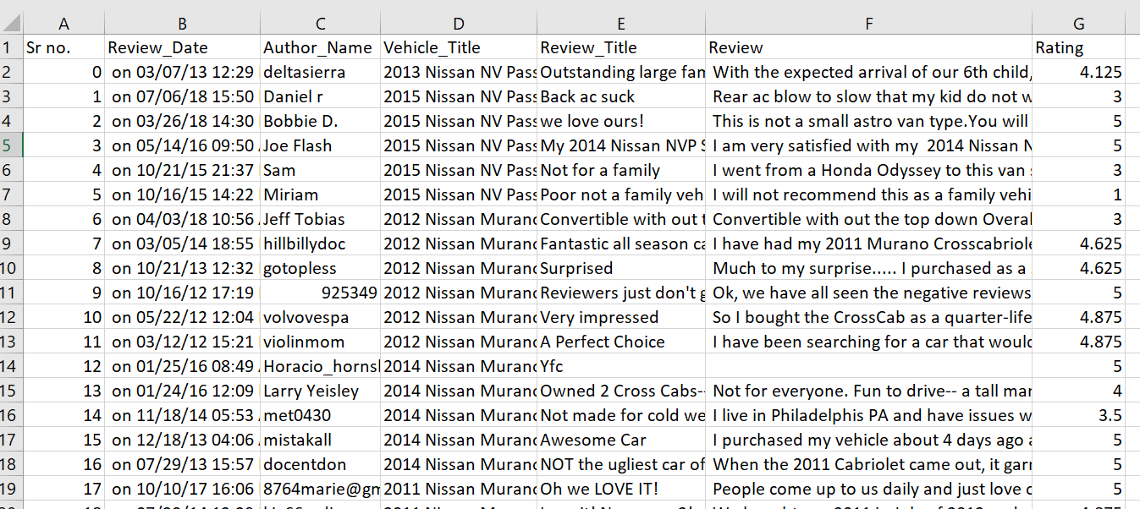

Dataset Description
Dataset is obtained from Kaggle, Edmunds-Consumer Car Ratings.
The dataset contains 11,715 reviews and ratings for different models of Nissan.

Slide 9
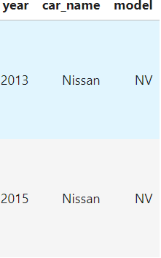
Dropping the columns
Checking for null values
Pickled the data frame for future use
Data
Pre
Processing
Interpolate on rating column
Lemmatization
Joining review title and review column
Eliminating stop-words
Splitting the vehicle into year, car name and model

Slide 10
Techniques Used
Natural Language Processing
Topic Modeling
Sentiment Analysis

Slide 11


Latent Dirichlet Allocation
LDA MULTICORE
LDA MALLET
The training algorithm is streamed i.e., Training documents may come in sequentially, no random access required.
It provides us the Mallet Topic Modeling toolkit which contains efficient, sampling implementations of LDA as well as Hierarchical LDA.

Slide 12
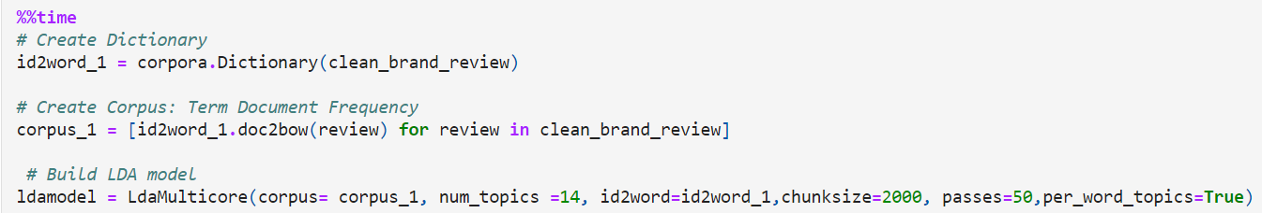
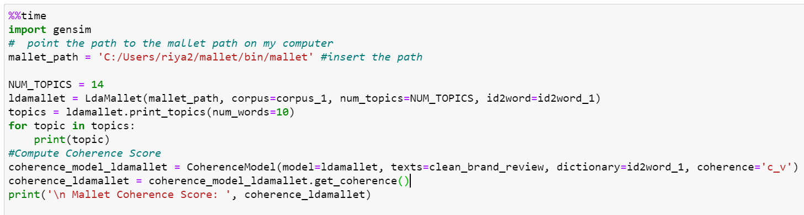
Parameters Of Topic Modelling

Slide 13
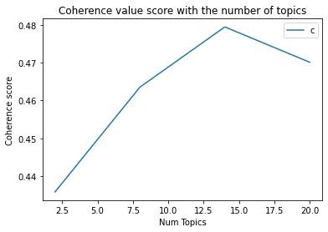
Optimum Number Of Topics
Topic 2 has coherence value of 0.4358
Topic 8 has coherence value of 0.4635
Topic 14 has coherence value of 0.4794
Topic 20 has coherence value of 0.4701

Slide 14
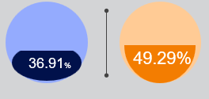
Accuracy Of Lda Models
LDA MULTICORE COHERENCE SCORE
LDA MALLET COHERENCE SCORE

Slide 15
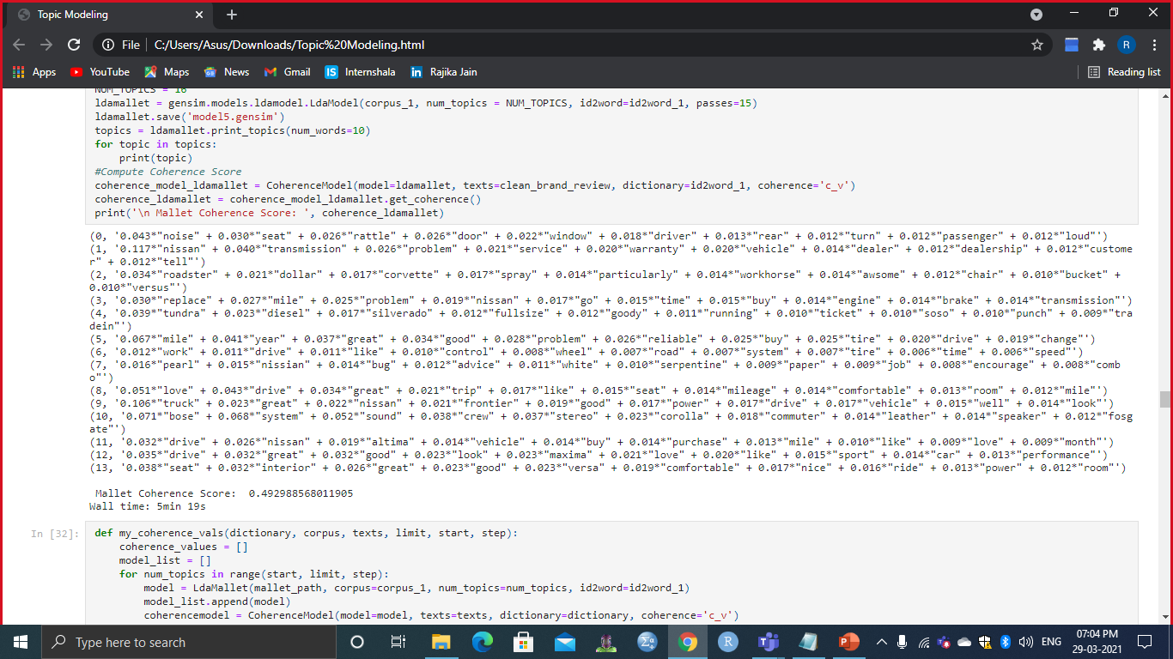
Visualisation Of 14 Topics

Slide 16








DOMINANT TOPICS
TOPIC 1 :
DEALERS AND SERVICES
TOPIC 2 :
SUITABLE FOR LONG JOURNEY
TOPIC 3 :
DRIVING ABILITY
TOPIC 4 :
CAR QUALITY
TOPIC 5 :
SPEED AND FUEL
TOPIC 6 :
SEAT COMFORT
TOPIC 7 :
WARRANTY ISSUE
TOPIC 8 :
MILEAGE AND COST

Slide 17

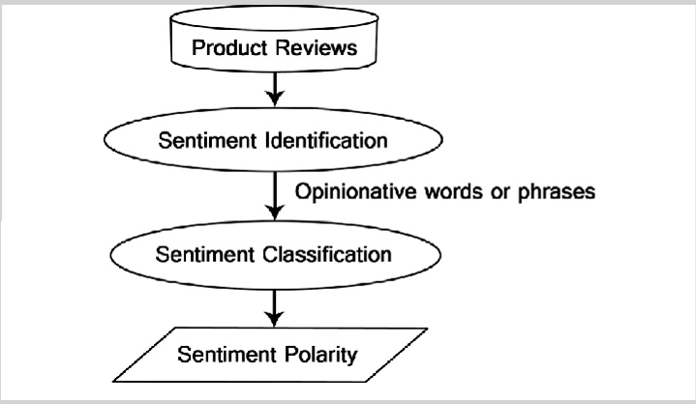
Sentiment Analysis
Sentiment analysis was performed on different models of brand Nissan by analyzing all the features for various models

Slide 18
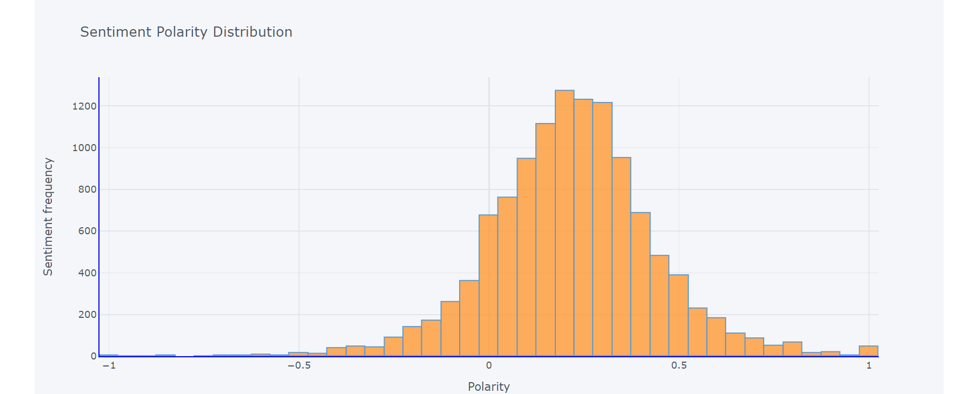
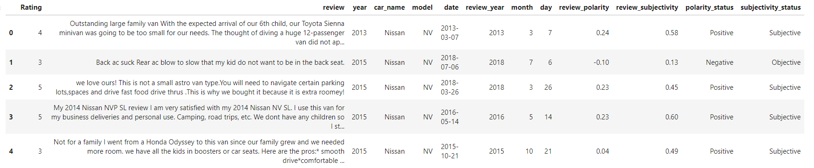
Subjectivity And Polarity
Polarity is a float which lying in the range of [-1,1].
Subjective sentences refer to opinion, emotion or judgement. It is also a float lying in the range of [0,1].

Slide 19
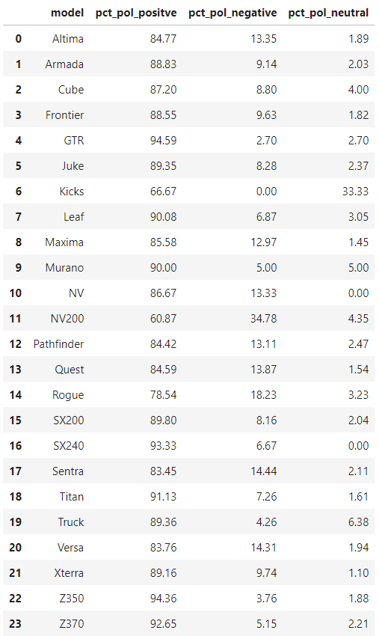
ACCURACY OF SENTIMENT ANALYSIS

Slide 20
Comparison Of Gt-r And Nv 200
GT-R
NV 200
The Nissan GT-R is a high-performance sports car and grand tourer produced by Nissan that was unveiled in 2007.
Very powerful engine of 565 bhp with less compromise on the mileage side.
The Nissan NV200 is a light commercial 4/5-door van.
Low power delivery of 130bhp,low ac performance, longer stopping distance.

Slide 21
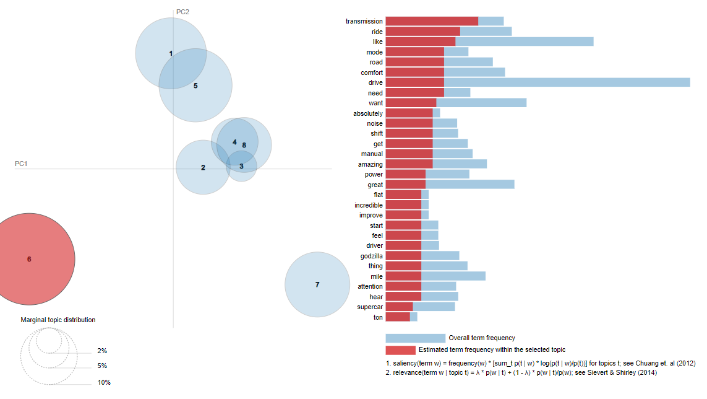
Gt-r

Slide 22
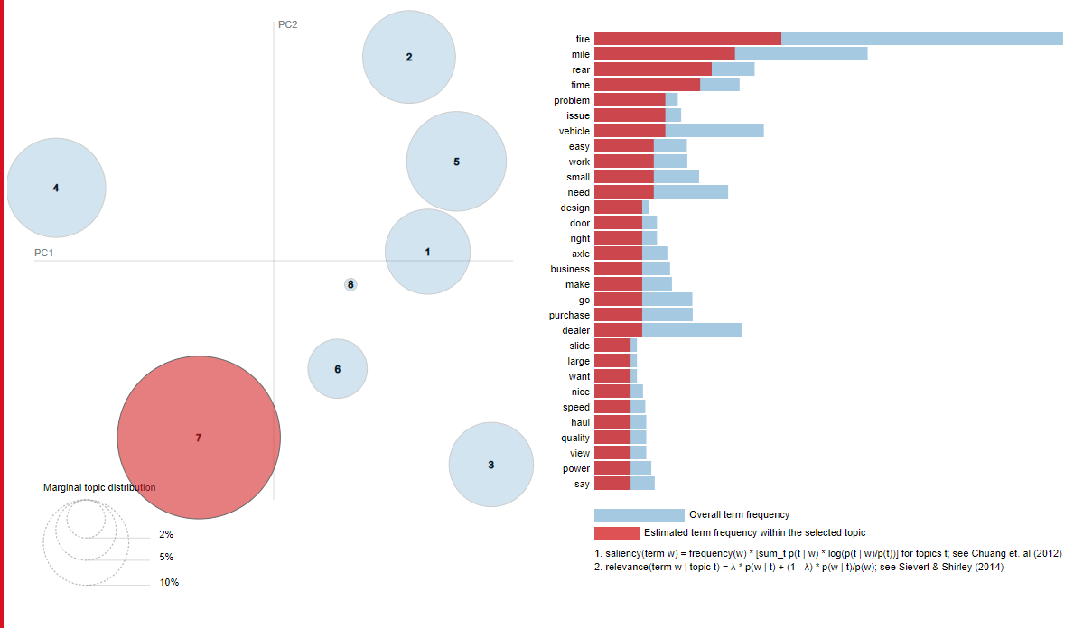
Nv200

Slide 23
Limitations
Considered car model irrespective of its variants.
Considered only the car models that were present in the dataset.
Lower accuracy for LDA due to limited number of Nissan Models.
Reviews were particularly based on Edmund ratings.

Slide 24
Recommendation
The company should focus on improving models with higher negative polarity and especially NV200.
Improvement of important factors as mentioned by the customers such as-
1.Improvement of Rear Air conditioning system in NV 200.
2.Better brakes in NV 200.
The company should continue to venture into other emerging markets.

Slide 25
Acknowledgement
We would like to extend our special thanks to Prof. Sunil Shirvaiker and Prof. Ketan Solanki for giving us the opportunity to work on this wonderful project and guiding us throughout our project.

Slide 26
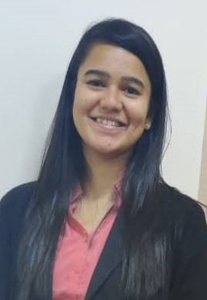
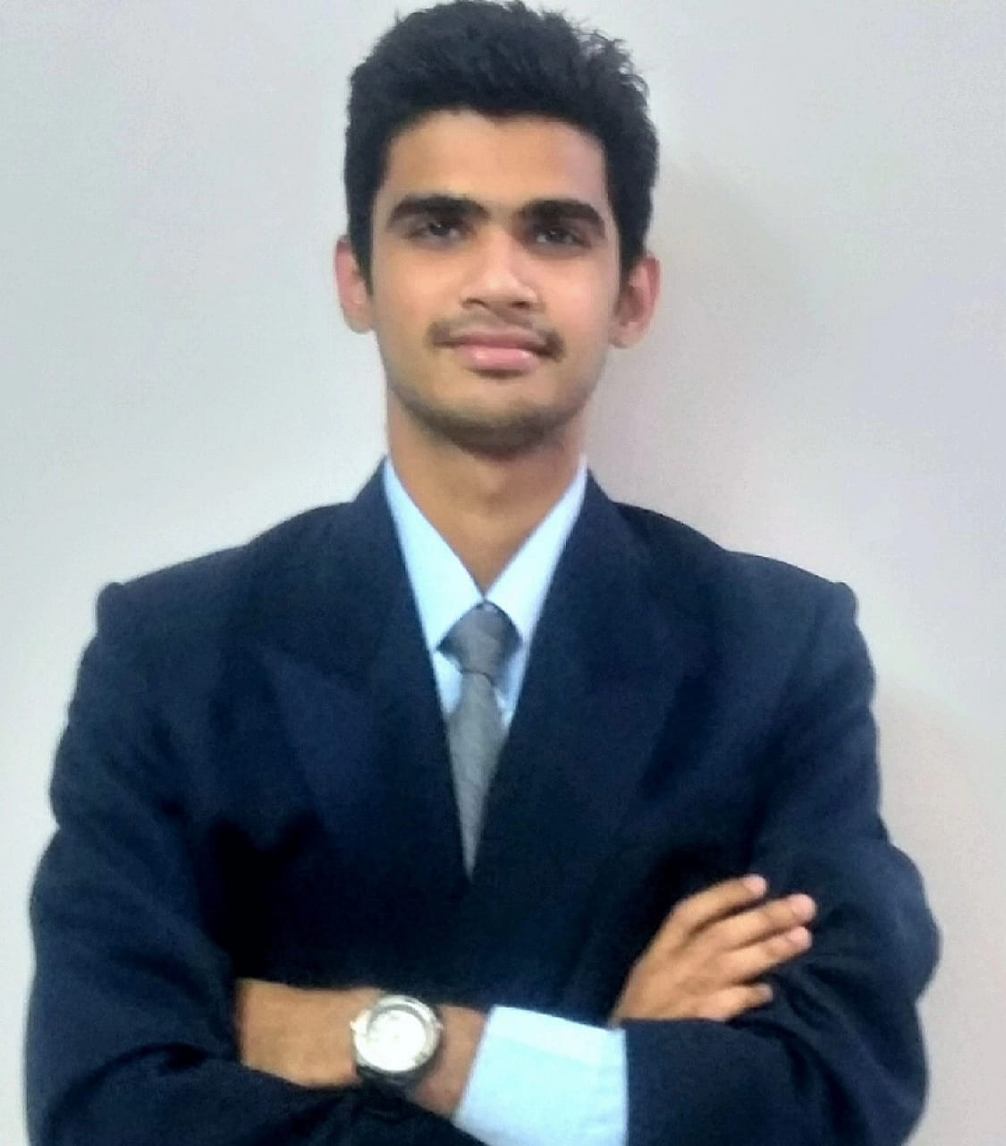

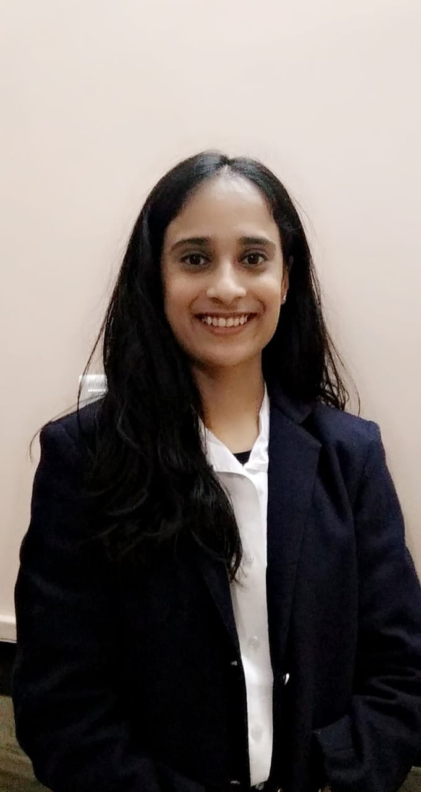
Thank You
Riya Anandpara (A006)
Bhavya Bhatt (A009)
Shantanu Bhowmick (A010)
Rajika Jain (A020)

